Slide 1
Italian Restaurant in New York
Italian cuisine is one of the best in the world. The aim of this project is to find the most popular neighborhoods with italian restaurants in the Big Apple. This can be useful for suggesting where to open another restaurant that can be the bearer of our beautiful culture. As part of this project, we will list and visualize all major New York City's boroughs that have great Italian resturants based on ratings, tips and likes. We will then conclude by proposing the most suitable and competitive neighborhood for opening a new activity.

Slide 2
Dataset and Foursquare
We get from this dataset the new york city data :
https://cocl.us/new_york_dataset
And with our personal Client ID on Foursquare, we can interact with FourSquare API and get top 100 venues within a radius of 1000 metres for a given latitude and longitude.

Slide 3
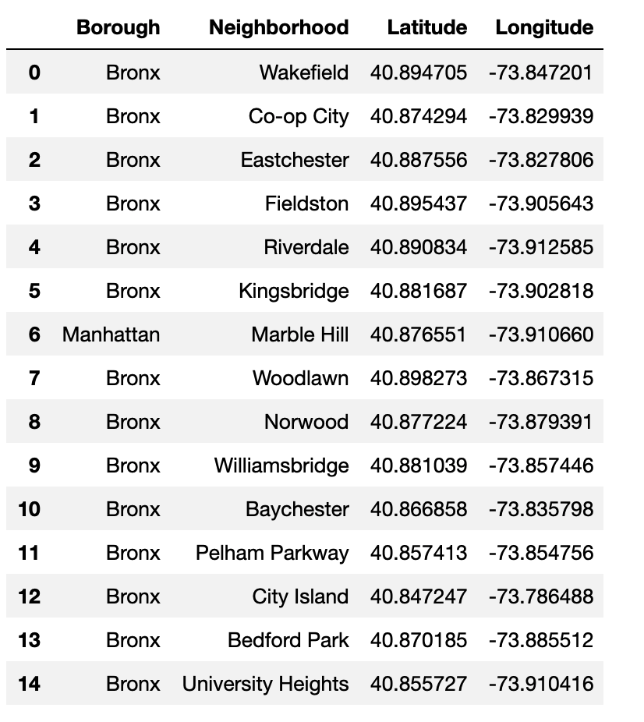
15 Rows of NewYork City data

Slide 4
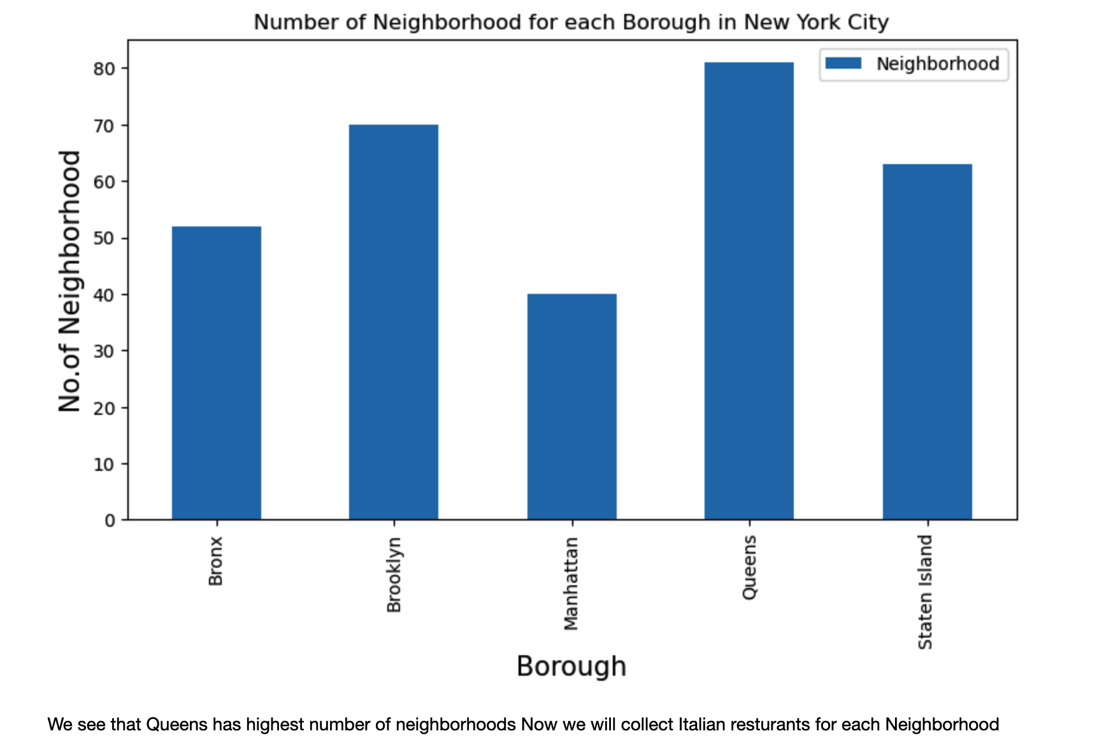
We see that Queens has highest number of neighborhoods.

Slide 5
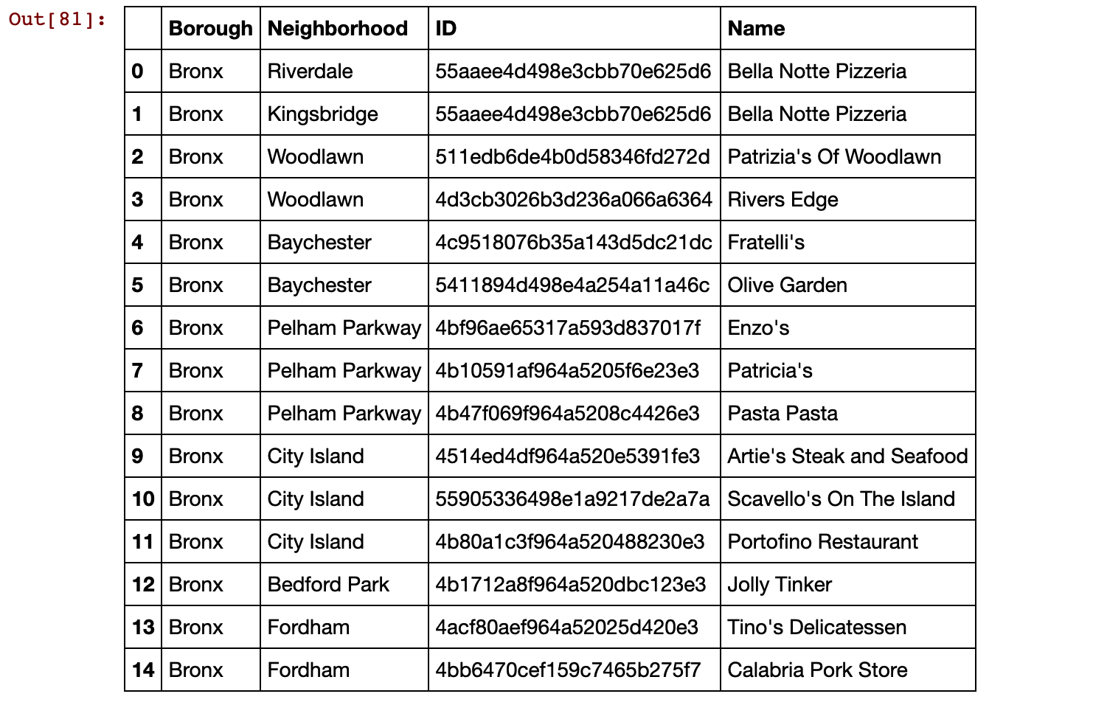
Now we focus at all the italian resturants in new york city , for Bronx, Brooklyn, Manhattam, Queens and staten island

Slide 6
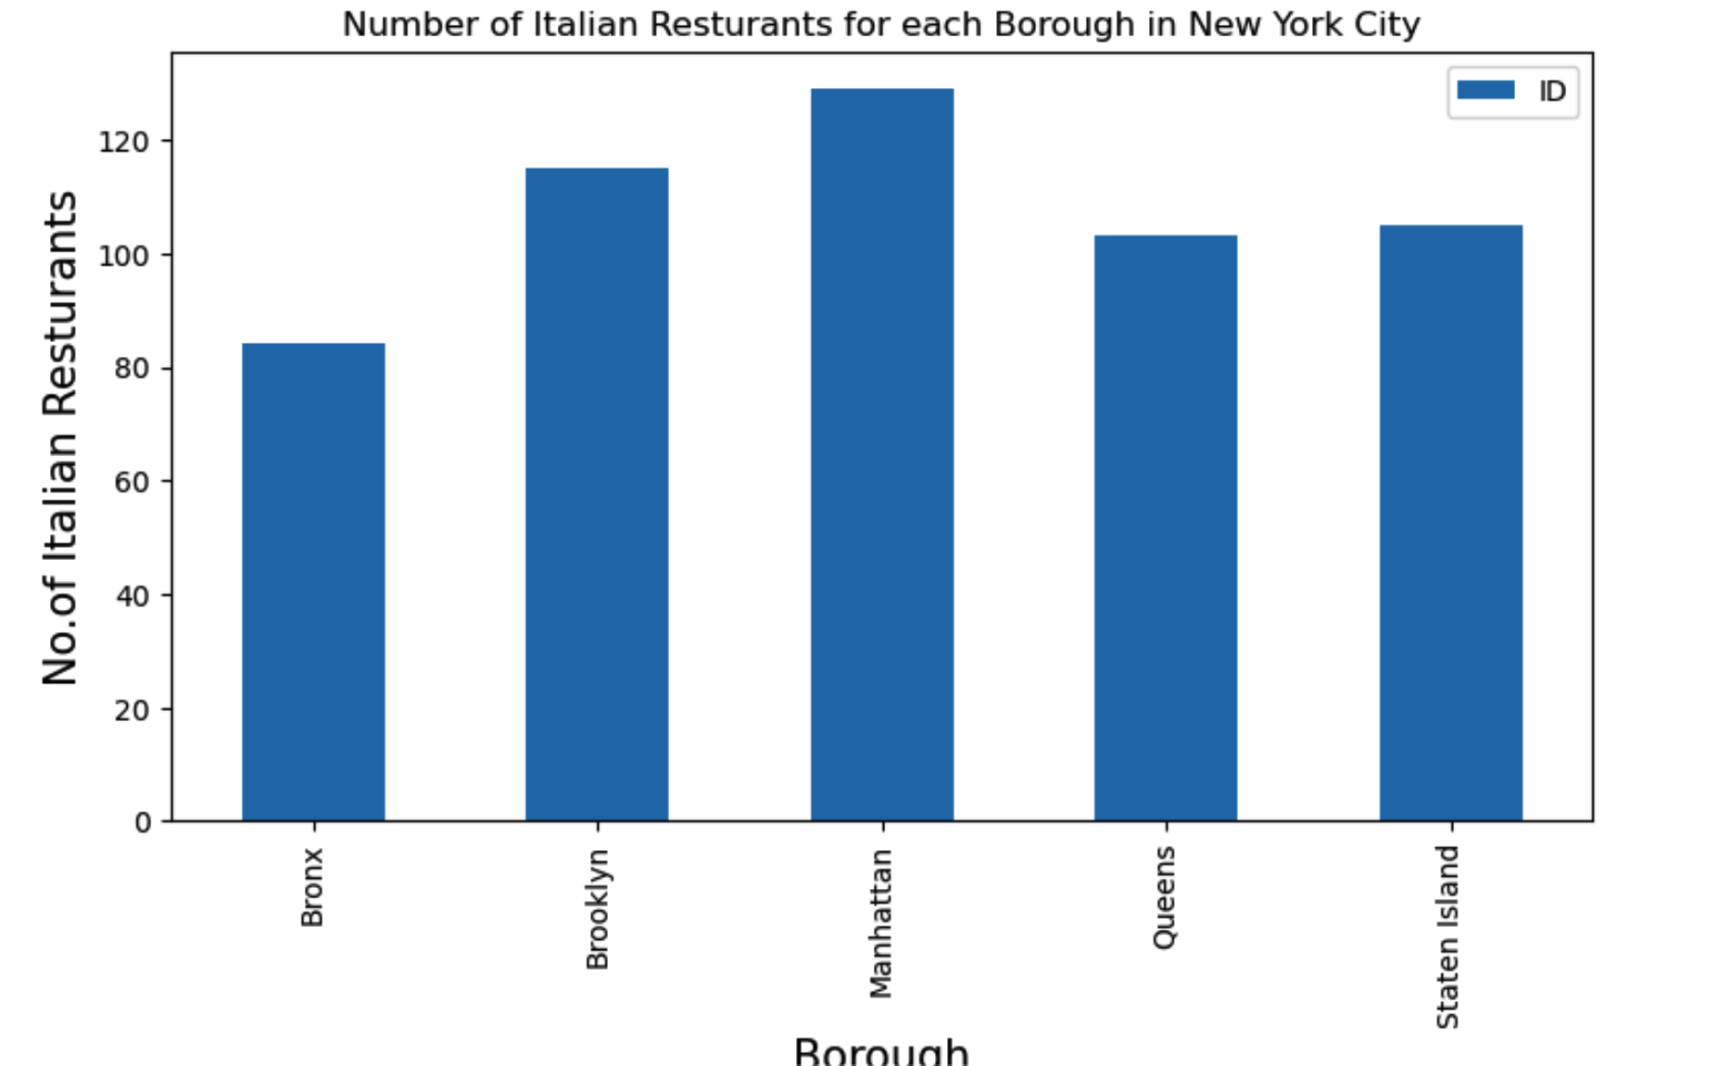
Number of Italian Resturants for each Borough in New York City

Slide 7
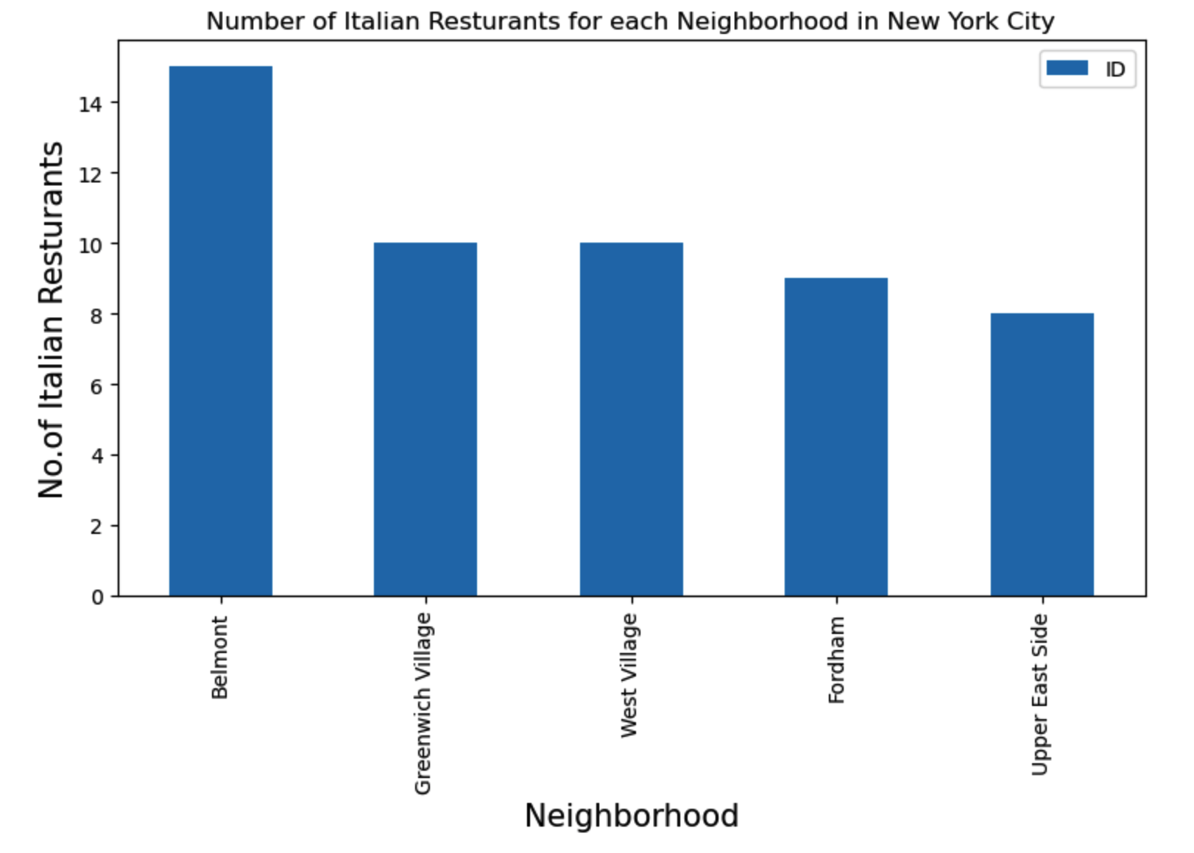
Number of Italian Resturants for each Neighborhood in New York City

Slide 8
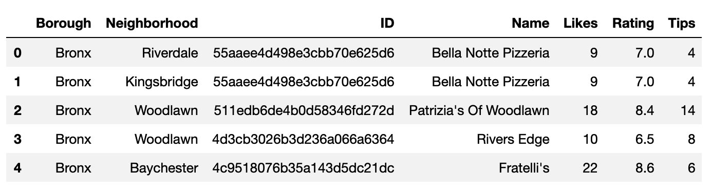
Since bronx has the highest number of italian restaurants, we focus on this Borough and create a csv file in which we add ’rating’, ‘tips’ and ‘likes’ for each restaurant.

Slide 9
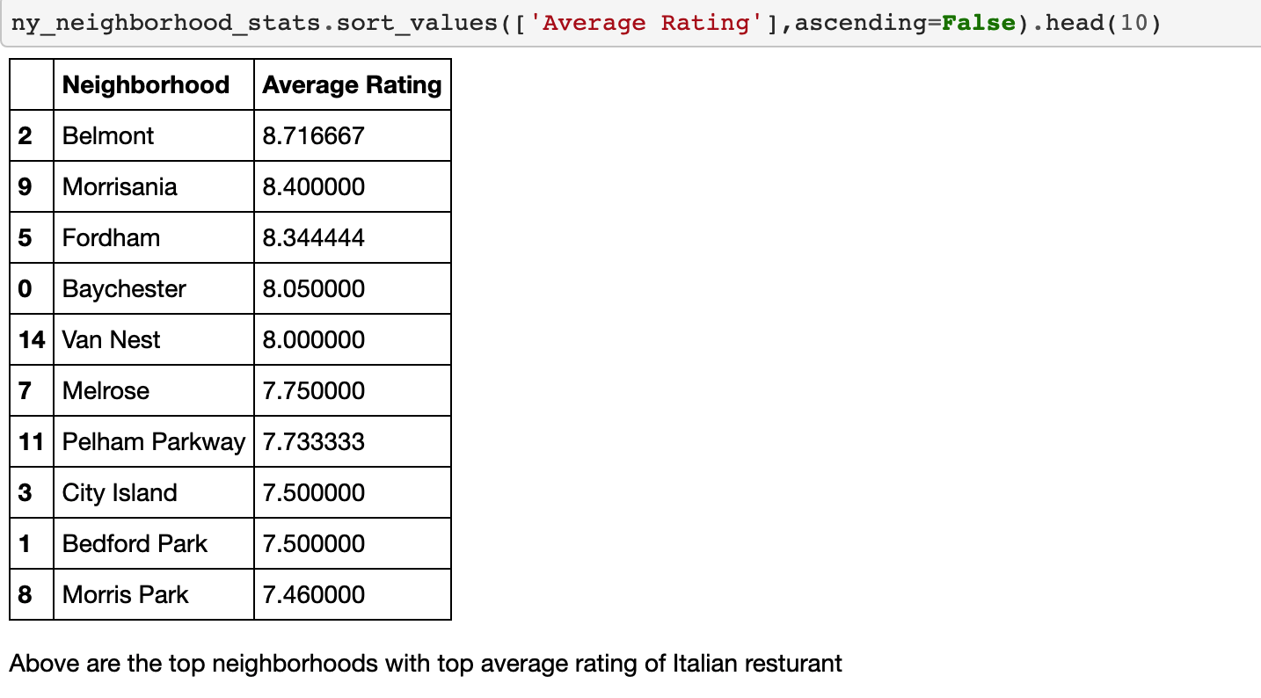
In the following The top average rating for each Bronx’s Neighborhoods

Slide 10
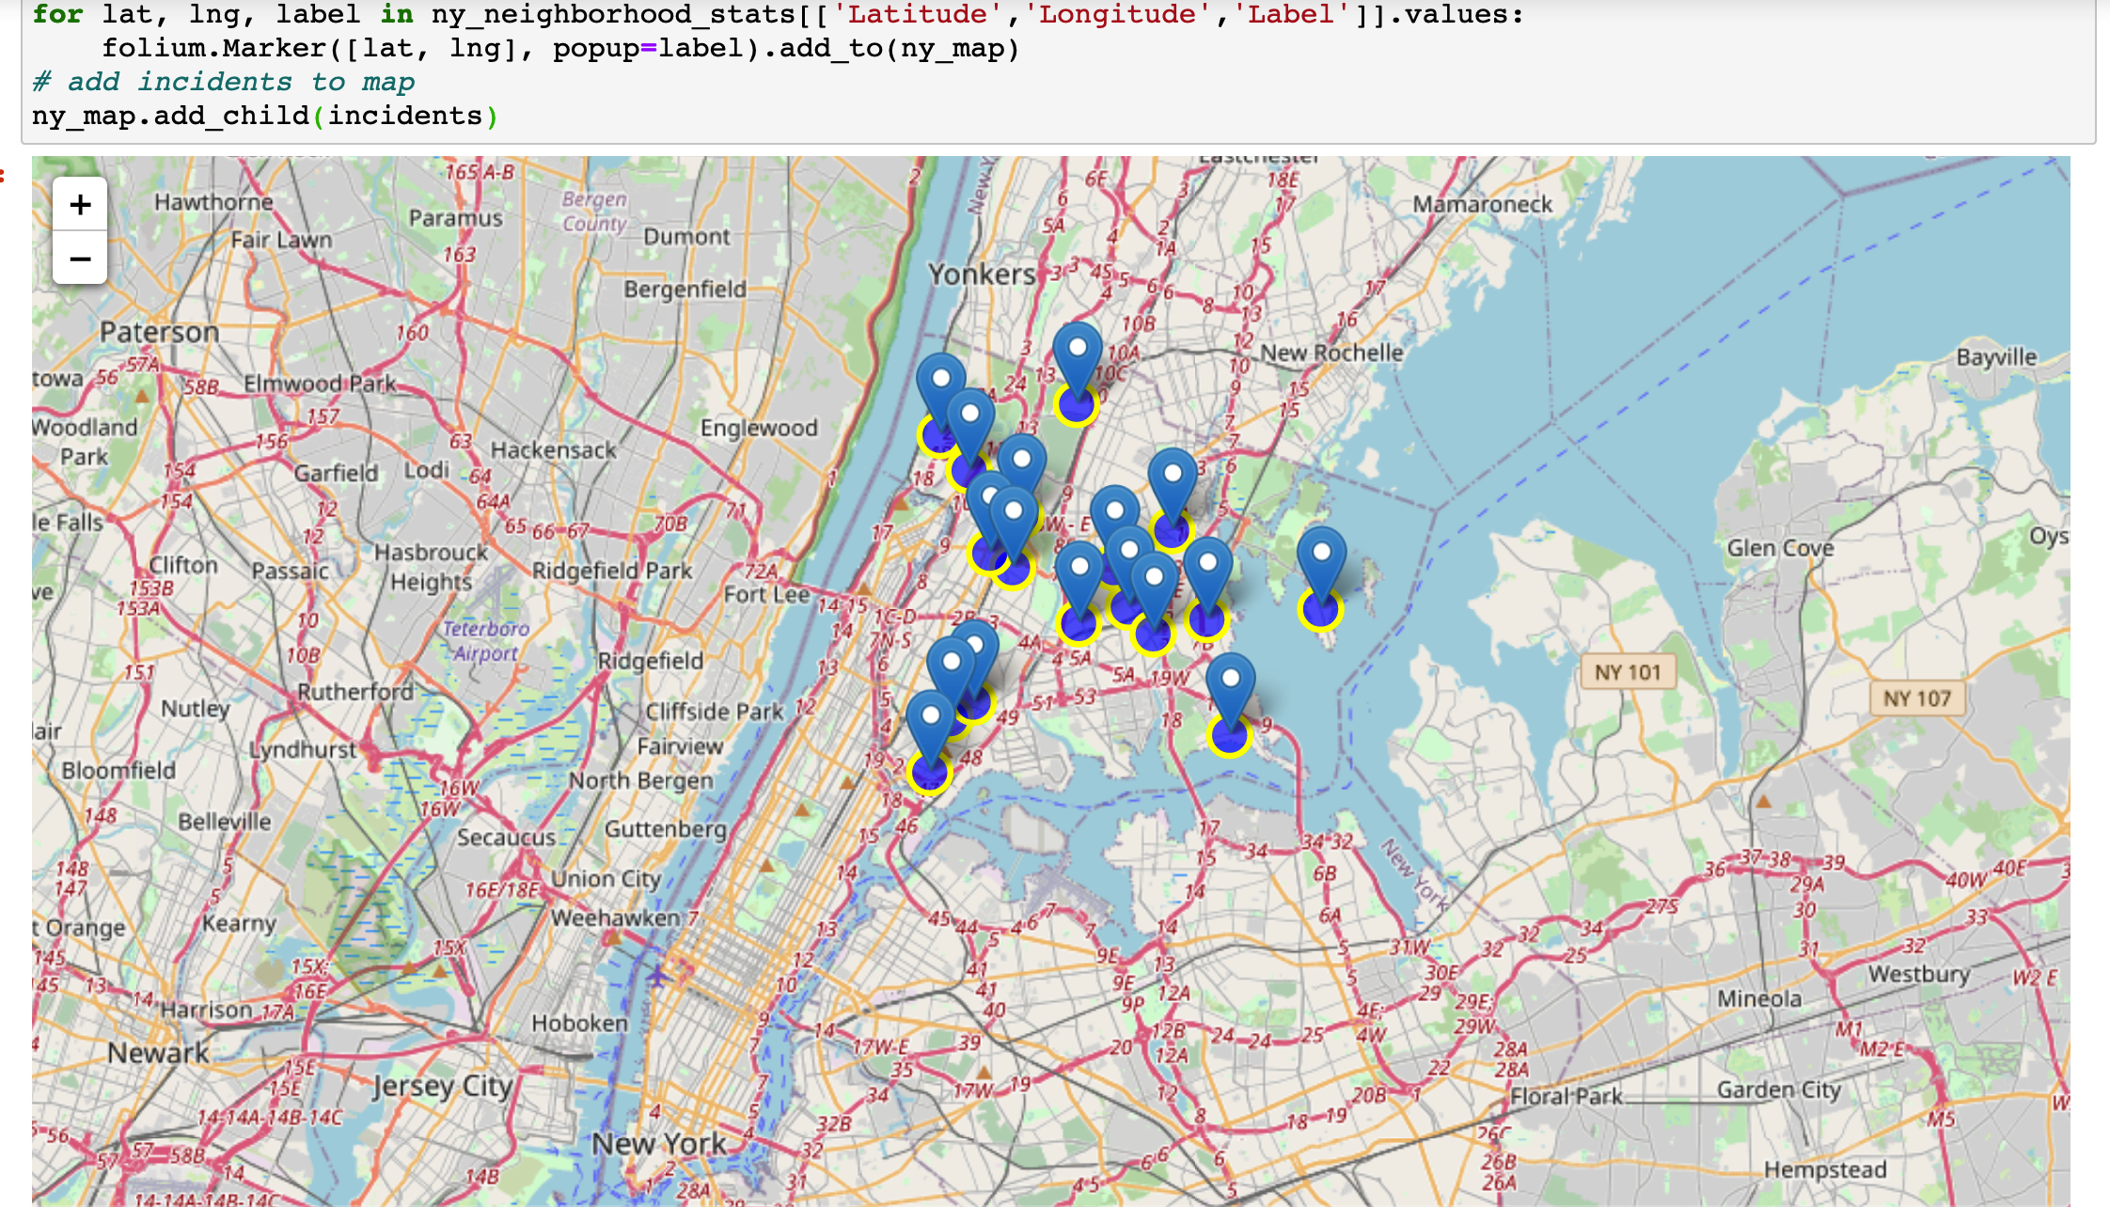
The last thing we do, is showing this data on a map

Slide 11
Conclusions:
This analysis provides that Bronx can be the most suitable for opening a new activity, beacuse we have the least number of italian restaurants, instead of Manhattam that have the most.
We also conclude that we need to focus on each Bronx’s neighborhood, because we see that Belmont is the most competitive neighborhood for opening a new activity.
Therefore a different neighborhood would be more suitable in order to be the bearer of the italian culture in that place.

